Slide 1
JAVA Applet
Rakesh Acharya

Slide 2
Java - Applet Basics
Life Cycle of an Applet:
Applets vs. Applications
Applet Inheritance
Simple Applet Program A "Hello, World" Applet:
Embedding an applet in an HTML file
Event Handling:
Simple Applet Program for Event Handling.
Adding different component into Applet(Like listbox,combobox,text box,button and table)
invoking one Applet from another Applet
Basics of Frame

Slide 3
Java - Applet Basics
An applet is a Java program that runs in a Web browser. An applet can be a fully functional Java application because it has the entire Java API at its disposal.
There are some important differences between an applet and a standalone Java application, including the following:
An applet is a Java class that extends the java.applet.Applet class.
A main() method is not invoked on an applet, and an applet class will not define main().
Applets are designed to be embedded within an HTML page.
When a user views an HTML page that contains an applet, the code for the applet is downloaded to the user's machine.
A JVM is required to view an applet. The JVM can be either a plug-in of the Web browser or a separate runtime environment.
The JVM on the user's machine creates an instance of the applet class and invokes various methods during the applet's lifetime.
Applets have strict security rules that are enforced by the Web browser. The security of an applet is often referred to as sandbox security, comparing the applet to a child playing in a sandbox with various rules that must be followed.
Other classes that the applet needs can be downloaded in a single Java Archive (JAR) file.

Slide 4
Life Cycle of an Applet:
Four methods in the Applet class give you the framework on which you build any serious applet:
init: This method is intended for whatever initialization is needed for your applet. It is called after the param tags inside the applet tag have been processed.
start: This method is automatically called after the browser calls the init method. It is also called whenever the user returns to the page containing the applet after having gone off to other pages.
stop: This method is automatically called when the user moves off the page on which the applet sits. It can, therefore, be called repeatedly in the same applet.
destroy: This method is only called when the browser shuts down normally. Because applets are meant to live on an HTML page, you should not normally leave resources behind after a user leaves the page that contains the applet.
paint: Invoked immediately after the start() method, and also any time the applet needs to repaint itself in the browser. The paint() method is actually inherited from the java.awt.

Slide 5
Applets vs. Applications
Extend Applet instead of Frame
Use of init( ) vs. constructor
No use of main( )
Default layout managers
application: BorderLayout
applet: FlowLayout
Security

Slide 6
Applet Inheritance
Object - “cosmic base class”
Component - button, listBox
Container - dialog box
Panel - “sub-window”, group of buttons, etc.
Applet - small application, web enabled
MyApplet - specific instance of an applet

Slide 7
import java.applet.*;
import java.awt.*;
import java.awt.event.*;
public class MyTextApplet extends Applet {
public void init() {
setBackground(Color.gray);
Panel p = new Panel();
ButtonAction aButtonAction = new ButtonAction();
p.setLayout(new FlowLayout());
tickButton = new Button("Tick");
tickButton.addActionListener(aButtonAction);
p.add(tickButton);
setButton = new Button("Set time");
setButton.addActionListener(aButtonAction);
p.add(setButton);
hourField = new TextField("12", 3);
p.add(hourField);
minuteField = new TextField("00", 3);
p.add(minuteField);
timeField = new TextField("", 12);
p.add(timeField);
add(p);
}

Slide 8
Class ButtonAction implements ActionListener
{
public void actionPerformed(ActionEvent evt)
{
String buttoncommand = evt.getActionCommand();
if (buttoncommand.equals("Tick"))
{
int minutes = Integer.parseInt(minuteField.getText());
minutes += 1;
String min = String.valueOf(minutes);
minuteField.setText(min);
}
else if (buttoncommand.equals("Set time"))
{
int hours = Integer.parseInt(hourField.getText());
int minutes = Integer.parseInt(minuteField.getText());
String tim = hourField.getText() + ":" +
minuteField.getText();
timeField.setText(tim);
}
}
} //end of ButtonAction
private TextField hourField;
private TextField minuteField;
private TextField timeField;
private Button tickButton;
private Button setButton;
}
<HTML>
<HEAD>
<TITLE> My Text Applet Demo </TITLE>
</HEAD>
<BODY background="Image1.jpg">
<H1> Here's my Demo Applet </H1>
<HR SIZE = 3>
<APPLET CODE = MyTextApplet WIDTH = 300 HEIGHT = 100>
</APPLET>
</BODY>
</HTML>

Slide 9
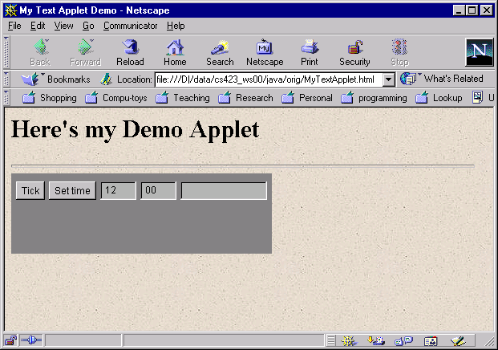
MyTextApplet Output

Slide 10
Simple Applet Program A "Hello, World" Applet:
import java.applet.*;
import java.awt.*;
public class HelloWorldApplet extends Applet {
public void paint (Graphics g)
{
g.drawString ("Hello World", 25, 50);
}
}

Slide 11
The Applet CLASS:
Every applet is an extension of the java.applet.Applet class. The base Applet class provides methods that a derived Applet class may call to obtain information and services from the browser context.
These include methods that do the following:
Get applet parameters
Get the network location of the HTML file that contains the applet
Get the network location of the applet class directory
Print a status message in the browser
Fetch an image
Fetch an audio clip
Play an audio clip
Resize the applet
Additionally, the Applet class provides an interface by which the viewer or browser obtains information about the applet and controls the applet's execution. The viewer may:
request information about the author, version and copyright of the applet
request a description of the parameters the applet recognizes
initialize the applet
destroy the applet
start the applet's execution
stop the applet's execution
The Applet class provides default implementations of each of these methods. Those implementations may be overridden as necessary.
The "Hello, World" applet is complete as it stands. The only method overridden is the paint method.

Slide 12
Invoking an Applet:
An applet may be invoked by embedding directives in an HTML file and viewing the file through an applet viewer or Java-enabled browser.
The <applet> tag is the basis for embedding an applet in an HTML file. Below is an example that invokes the "Hello, World" applet:
<html>
<title>The Hello, World Applet</title>
<hr>
<applet code="HelloWorldApplet.class" width="320" height="120">
If your browser was Java-enabled, a "Hello, World"
message would appear here.
</applet>
<hr>
</html>

Slide 13
<!DOCTYPE html>
<html>
<head>
<title>HTML applet Tag</title>
</head>
<body>
<applet code="newClass.class" width="300" height="200">
</applet>
</body>
</html>
Here is the newClass.java file:
import java.applet.*;
import java.awt.*;
public class newClass extends Applet
{
public void paint (Graphics gh)
{
g.drawString("Tutorialspoint.com", 300, 150);
}
}
This will produce following result:

Slide 14
Getting Applet Parameters:
The applet viewer or browser calls the init() method of each applet it runs. The viewer calls init() once, immediately after loading the applet.
(Applet.init() is implemented to do nothing.) Override the default implementation to insert custom initialization code.
The Applet.getParameter() method fetches a parameter given the parameter's name (the value of a parameter is always a string). If the value is numeric or other non-character data, the string must be parsed.
import java.applet.*;
import java.awt.*;
public class CheckerApplet extends Applet
{
public void init ()
{
String squareSizeParam = getParameter ("squareSize");
// parseSquareSize (squareSizeParam);
String colorParam = getParameter ("color");
setBackground (Color.GREEN);
}
public void paint (Graphics gh)
{
gh.drawString("Welcome To CSC ", 300, 150);
}
}

Slide 16
Event Handling:
Applets inherit a group of event-handling methods from the Container class. The Container class defines several methods, such as processKeyEvent and processMouseEvent, for handling particular types of events, and then one catch-all method called processEvent.
import java.awt.event.MouseListener;
import java.awt.event.MouseEvent;
import java.applet.Applet;
import java.awt.Graphics;
public class ExampleEventHandling extends Applet implements MouseListener {
StringBuffer strBuffer;
public void init() {
addMouseListener(this);
strBuffer = new StringBuffer();
addItem("initializing the apple ");
}
public void start() {
addItem("starting the applet ");
}
public void stop() {
addItem("stopping the applet ");
}
public void destroy() {
addItem("unloading the applet");
}
void addItem(String word) {
System.out.println(word);
strBuffer.append(word);
repaint();
}
public void paint(Graphics g) {
//Draw a Rectangle around the applet's display area.
g.drawRect(0, 0, getWidth() - 1, getHeight() - 1);
//display the string inside the rectangle.
g.drawString(strBuffer.toString(), 10, 20);
}

Slide 17
public void mouseEntered(MouseEvent event) {
}
public void mouseExited(MouseEvent event) {
}
public void mousePressed(MouseEvent event) {
}
public void mouseReleased(MouseEvent event) {
}
public void mouseClicked(MouseEvent event) {
addItem("mouse clicked! ");
}
}
<html>
<title>Event Handling</title>
<hr>
<applet code="ExampleEventHandling.class" width="300" height="300">
</applet>
<hr>
</html>

Slide 18
Displaying Images:
<html>
<title>The ImageDemo applet</title>
<hr>
<applet code="ImageDemo.class" width="300" height="200">
<param name="image" value="java.jpg">
</applet>
<hr> </html>
import java.applet.*;
import java.awt.*;
import java.net.*;
public class ImageDemo extends Applet
{
private Image image;
private AppletContext context;
public void init()
{
context = this.getAppletContext();
String imageURL = this.getParameter("image");
if(imageURL == null)
{
imageURL = "java.jpg";
}
try
{
URL url = new URL(this.getDocumentBase(), imageURL);
image = context.getImage(url);
}catch(MalformedURLException e)
{
e.printStackTrace();
// Display in browser status bar
context.showStatus("Could not load image!");
}
}
public void paint(Graphics g)
{
context.showStatus("Displaying image");
g.drawImage(image, 0, 0, 200, 84, null);
g.drawString("www.javalicense.com", 35, 100);
}
}

Slide 19
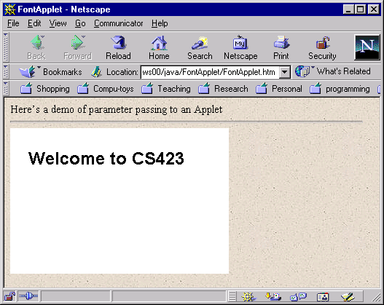
Parameter Passing to Applets
import java.applet.*;
import java.awt.*;
public class FontApplet extends Applet
{
public void paint (Graphics g)
{
String fontName = getParameter ("font");
int fontSize = Integer.parseInt (getParameter("size"));
Font f = new Font(fontName, Font.BOLD, fontSize);
g.setFont (f);
g.drawString("Welcome to CS423", 25, 50);
}
}
<HTML>
<TITLE> FontApplet </TITLE>
<BODY background=“Image1.jpg”>
Here’s a demo of parameter passing to an Applet
<hr>
<APPLET CODE = "FontApplet" WIDTH = 300 HEIGHT = 200>
<PARAM NAME = font VALUE = "Helvetica">
<PARAM NAME = size VALUE = "24">
</APPLET>
</BODY>
</HTML>

